Slide 1

Machine Learning Algorithms to Correct Images to Help the Color Blind
Jimmy Hickey
Winona State University
April 25th 2018

Slide 2
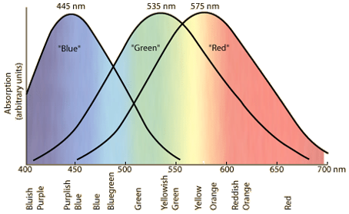
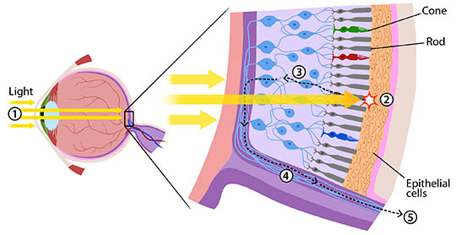
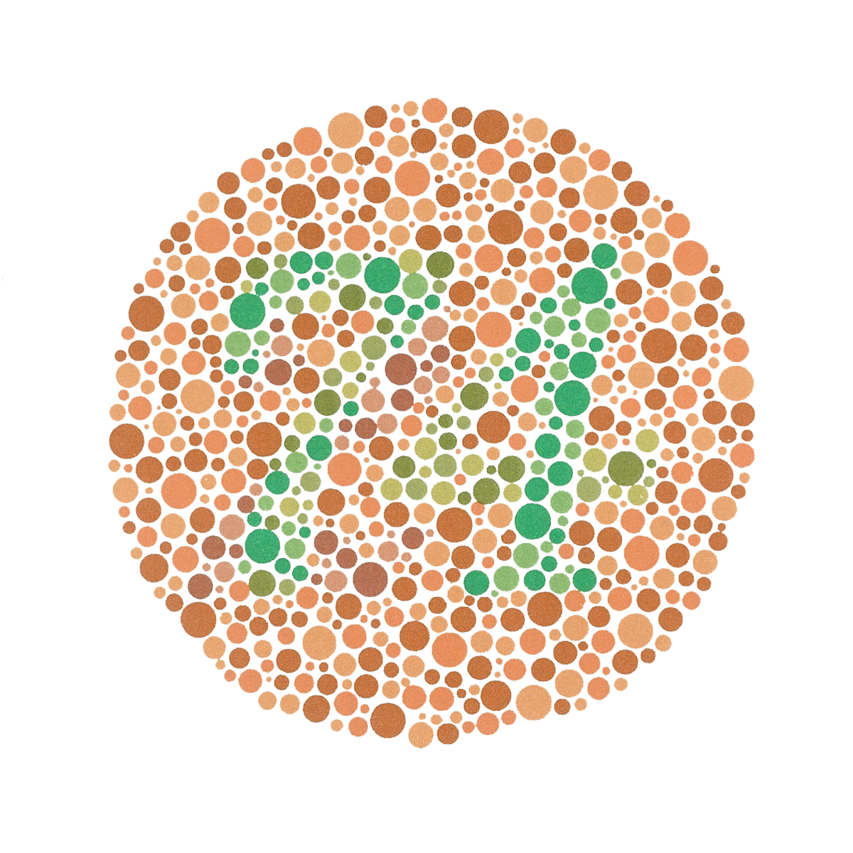
Color Blindness
We can still see colors!
https://askabiologist.asu.edu/rods-and-cones
http://hyperphysics.phy-astr.gsu.edu/hbase/vision/colcon.html
https://en.wikipedia.org/wiki/Ishihara_test

Slide 3
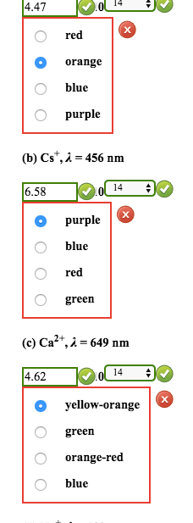
Goals
Identify colorblind problem areas
Correct these issues without destroying the image
Apply the system to any image

Slide 4




Data Creation
Data created rather than using Ishihara test
Drawn using Adobe Photoshop
Images with many color combinations

Slide 5
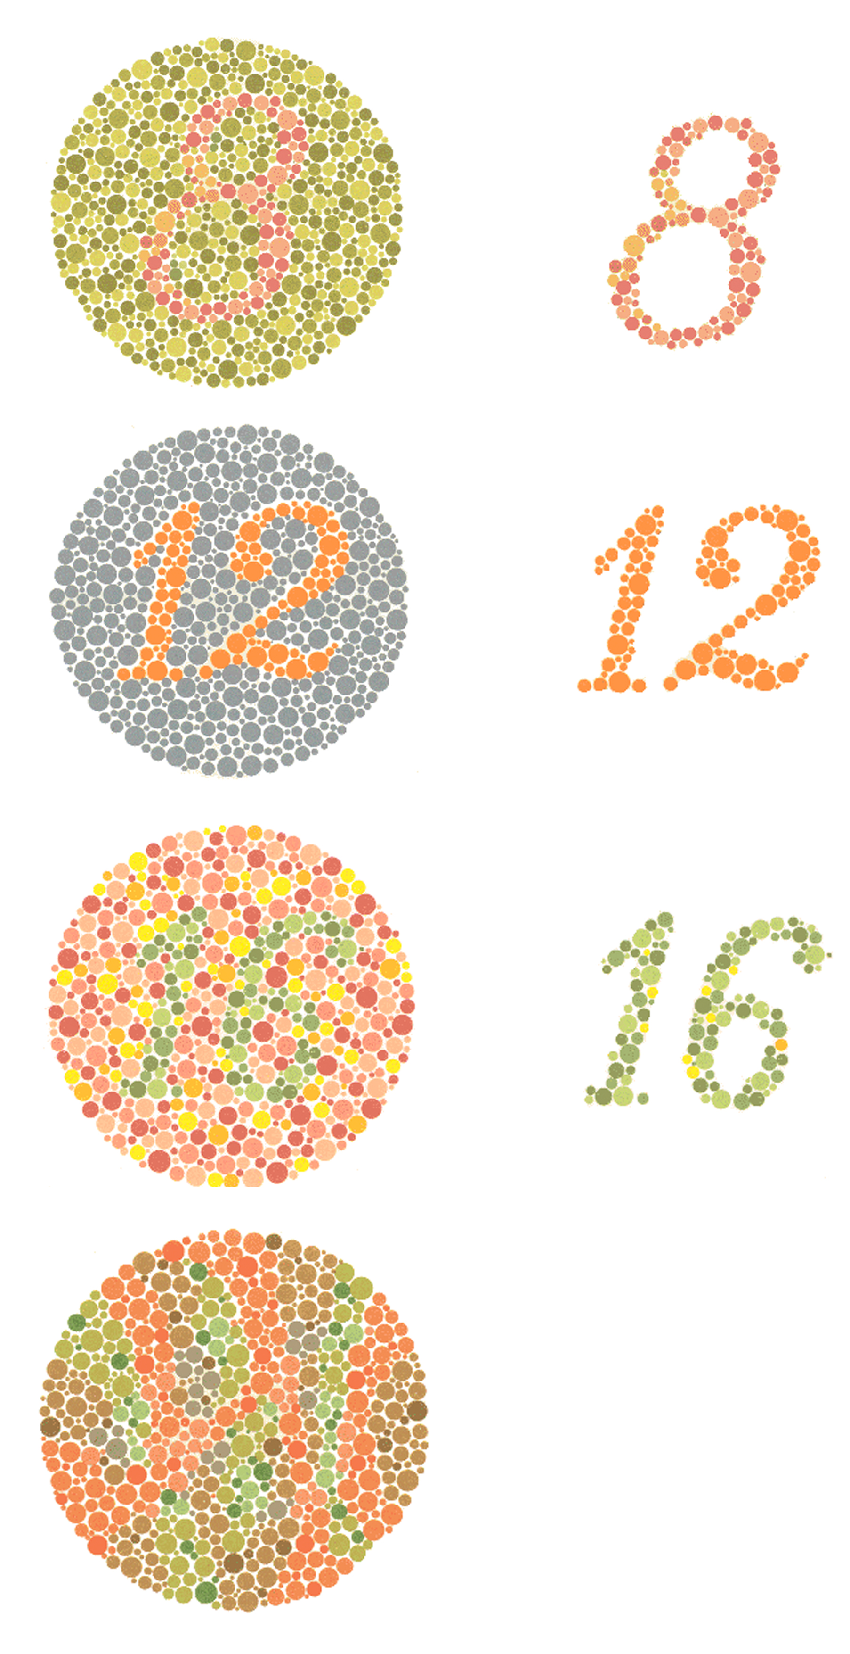
Color Detection
Unsupervised learning pattern recognition
Examine RGB value of each pixel in an image
Learn which combination of values are problematic
https://chrismarkland.wordpress.com/2012/02/28/map-specific/

Slide 6

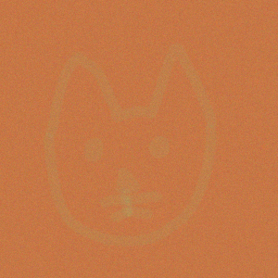

Adding Noise
mean = 0
sd = 3
np.ceil(np.random.normal(mean, sd))

Slide 7
K-Means Clustering

Slide 8
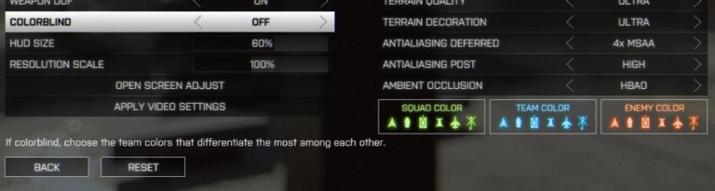
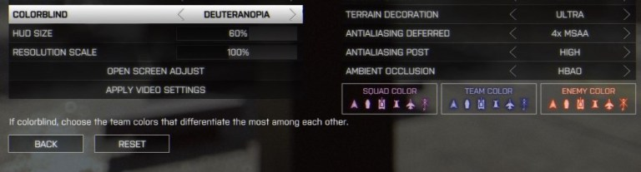
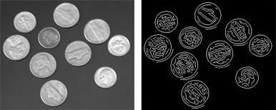
Color Correction
http://www.gamersexperience.com/colorblind-accessibility-in-video-games-is-the-industry-heading-in-the-right-direction/
Edge detection
Color reassignment
A different implementation of color reassignment.
https://www.mathworks.com/discovery/edge-detection.html

Slide 9
Edge Detection

Slide 10
Color Correction

Slide 11
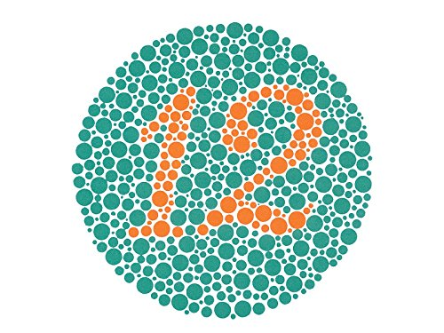
Flaws and Improvements
Non-representative data
No expert opinions
No user feedback
https://www.amazon.com/KANEHARA-Ishihara-Chart-Deficiency-Plates/dp/B00MAVIR3Y

Slide 12
References
https://opendyslexic.org/

